Slide 1

Communication
Teaching Resource

Slide 2
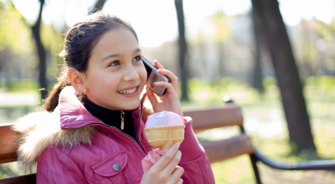







Images courtesy of Rosen Georgiev, nenetus, Ambro, stockimages and Stuart Miles at www.FreeDigitalPhotos.net
Year 4 Learning Activity: Online vs face-to-face communication
© Government of Western Australia Department of Health <<www.gdhr.wa.gov.au>>

Slide 3
Group 2
Group 1
Images courtesy of Rosen Georgiev, nenetus, Ambro, stockimages and Stuart Miles at www.FreeDigitalPhotos.net
Year 4 Learning Activity: Online vs face-to-face communication
© Government of Western Australia Department of Health <<www.gdhr.wa.gov.au>>

Slide 4
 | Positives | Challenges
Text Only | E.g. quick | E.g. easily recorded
Photos
Videos
Face to Face (in person)

Slide 5

Can you talk to me after school?
I didn’t mean to hurt your feelings.
What do you want?
Wow, okay then
Oops!!!
Okay… sure
Wait, WHAT!?
Hellooooo??
Why didn’t you reply to me?

Slide 6
Scenarios
One: You receive a text message from a ‘friend’ that mentioned your name and an insult to your new shoes. The friend who sent the message quickly sends follow up messages saying, “OMG wrong person…” and “Lol, I was only joking”, and “Pls don’t be mad”. You suspect that this friend sent this message to you by mistake.
Two: Someone who you don’t know very well from an older year in a school nearby keeps messaging you on an online gaming website, even after you’ve said stop.
Three: You find out that a group of your friends have all planned to go to the movies on the weekend and have made a group chat about it. They keep talking about it in front of you at school. You weren’t added to the group chat and aren’t sure if you’re invited.
Four: You made a joke in class, and a classmate sends you a text message after school saying, “I didn’t find it very funny and am upset you’d joke about that sort of thing.” You realise the joke was silly and feel guilty for making it. You want to apologise as soon as possible.

Slide 7
Reflection
What was the most important thing you learnt about technology?
How is communicating online similar to communicating face to face?
How is communicating online different to communicating face to face?
What are the issues of communicating online?
How can you look after yourself and your friends and family if you are using your mobile phone or the internet?

