Slide 1

Communication
Teaching Resource

Slide 2
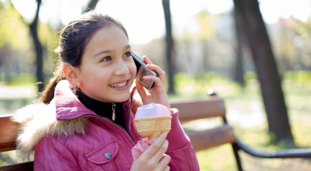







Images courtesy of Rosen Georgiev, nenetus, Ambro, stockimages and Stuart Miles at www.FreeDigitalPhotos.net
Year 4 Learning Activity: Online vs face-to-face communication
© Government of Western Australia Department of Health <<www.gdhr.wa.gov.au>>

Slide 3
Reflection
What was the most important thing you learnt about technology?
How is communicating online similar to communicating face to face?
How is communicating online different to communicating face to face?
What are the issues of communicating online?
How can you look after yourself and your friends and family if you are using your mobile phone or the internet?

